Slide 1

Consciousness
Finding a Place for Consciousness in the Natural World

Slide 2
What are we going to be looking at?
The Mind-Body Problem
The Hard Problem and the Easy Problems
Some proposed solutions and problems (physicalism and dualism)
The Search for the Neural Correlates of Consciousness (NCC)

Slide 3
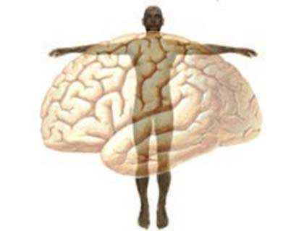
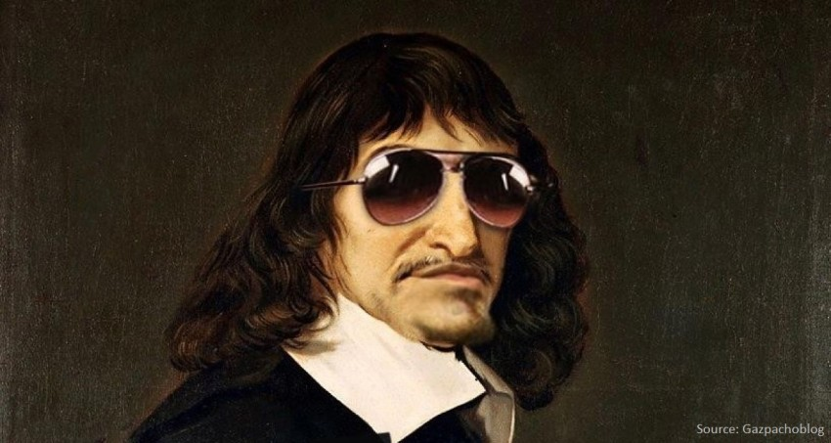
What is the Mind-Body Problem? Have we solved it?

Slide 4
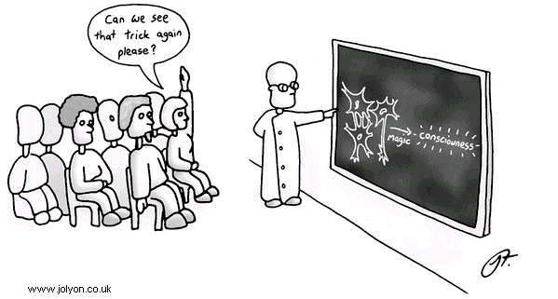
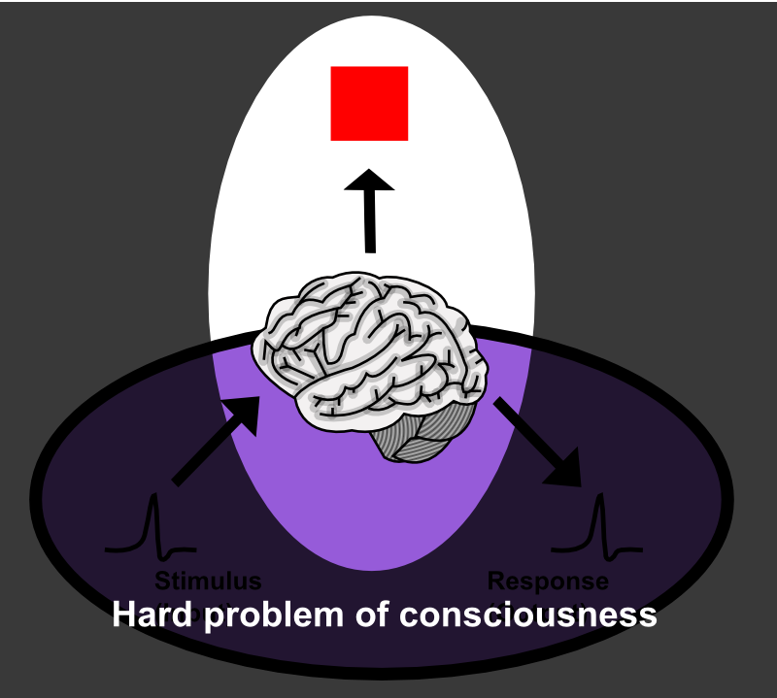
What is the so-called hard problem of consciousness?
Hard problem of consciousness
Hard problem of consciousness

Slide 5
What is the so-called hard problem of consciousness?
The hard problem of consciousness
Why on earth should all of these physical processes feel like something from the inside?
Why aren’t we just complicated robots that can take in information, process it, respond to it, without there being any ‘inner movie”?
This is THE problem
Why “hard”?
What are the ”easy problems”? Why easy?

Slide 6
What is the so-called hard problem of consciousness?
“Why is it that when our cognitive systems engage in visual and auditory information processing, we have visual or auditory experience: the quality of deep blue, the sensation of middle C? How can we explain why there is something it is like to entertain a mental image, or to experience an emotion? It is widely agreed that experience arises from the brain, but we have no good explanation of why and how it so arises. Why should physical processing give rise to a rich inner life at all? It seems objectively unreasonable that it should, and yet it does. If any problem qualifies as the problem of consciousness, it is this one” (Chalmers, 1995)

Slide 7
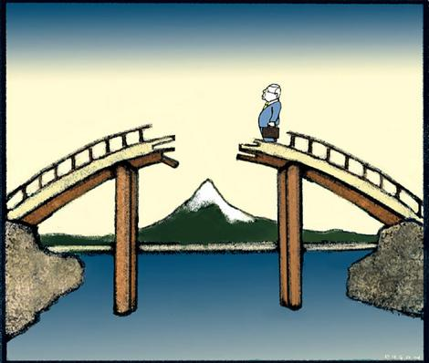
What is the so-called hard problem of consciousness?
The explanatory gap (Levine, 1983)
1. Physicalist accounts only explain structure (spatiotemporal structure) and function (causal role)
2. Explaining structure and function does not explain consciousness
3. Therefore, physicalist accounts are inadequate

Slide 8
What is the so-called hard problem of consciousness?
Think about it
Everything else in nature can be explained completely by structure and function
Reproduction
Growth
Cell behavior
Atomic behavior
Neural Behavior
But structure and function does not explain awareness
Why should structure be aware at a certain degree of complexity?
Our structural picture does not predict awareness

Slide 9
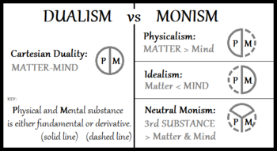
Proposed Solutions and Problems

Slide 10

Physicalism and its problems: the Knowledge Argument
Remember, physicalism says that everything is physical and everything can be explained in physical terms (the stuff we learn in physics, chemistry, and biology)
Mary, the Color Scientist thought experiment (Jackson, 1982)

Slide 11
Physicalism and its problems: the Knowledge Argument
“Mary is a brilliant scientist who is, for whatever reason, forced to investigate the world from a black and white room via a black and white television monitor. She specializes in the neurophysiology of vision and acquires, let us suppose, all the physical information there is to obtain about what goes on when we see ripe tomatoes, or the sky, and use terms like ’red’, ‘blue’, and so on. She discovers, for example, just which wavelength combinations from the sky stimulate the retina, and exactly how this produces via the central nervous system the contraction of the vocal chord and the expulsion of air from the lungs that results in the uttering of the sentence “The sky is blue’… What will happen when Mary is released from her black and white room or is given a color television monitor? Will she learn anything or not? It just seems obvious that she will learn something about the world and our visual experience of it. But then it is inescapable that her previous knolwedge was incomplete. But she has all the physical information. Ergo there is more to have than that, and Physicalism is false” – Frank Jackson, 1982

Slide 12
Physicalism and its problems: the Knowledge Argument
1. There are truths about experience that are not deducible from physical truths.
2. If there are truths about experience that are not deducible from physical truths, then physicalism is false.
3. Therefore, physicalism is false.
(Chalmers, 2011)

Slide 13
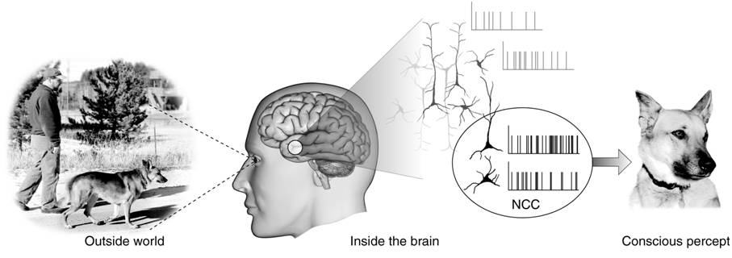
Can we ever solve the problem?
Some scientists think the hard problem is impossible to solve
Mysterianism e.g. Colin McGinn
We should instead look for the Neural Correlates of Consciousness (NCC)

Slide 14
Neural Correlates of Consciousness: An Easy Problem

Slide 15
Watch: Roundtable on Consciousness
https://www.closertotruth.com/roundtables/what-consciousness

